Slide 1
Short-range order in hydrogen diffusion of FCC materials
Gavin DeBrun, Youfu Qian, Daegun You

Slide 2
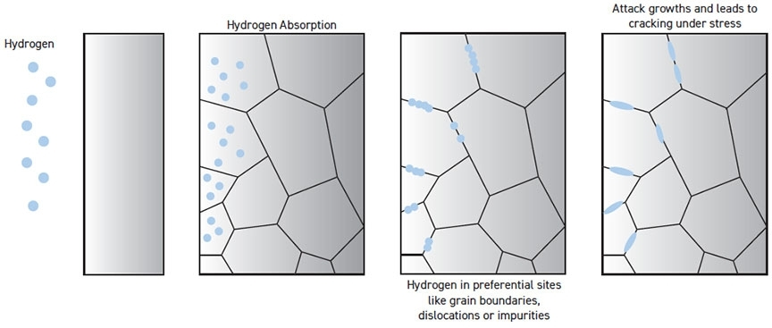
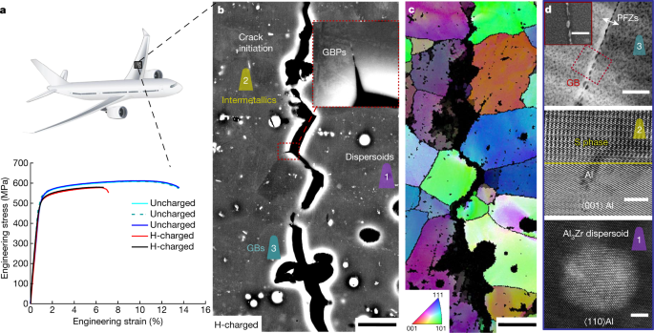

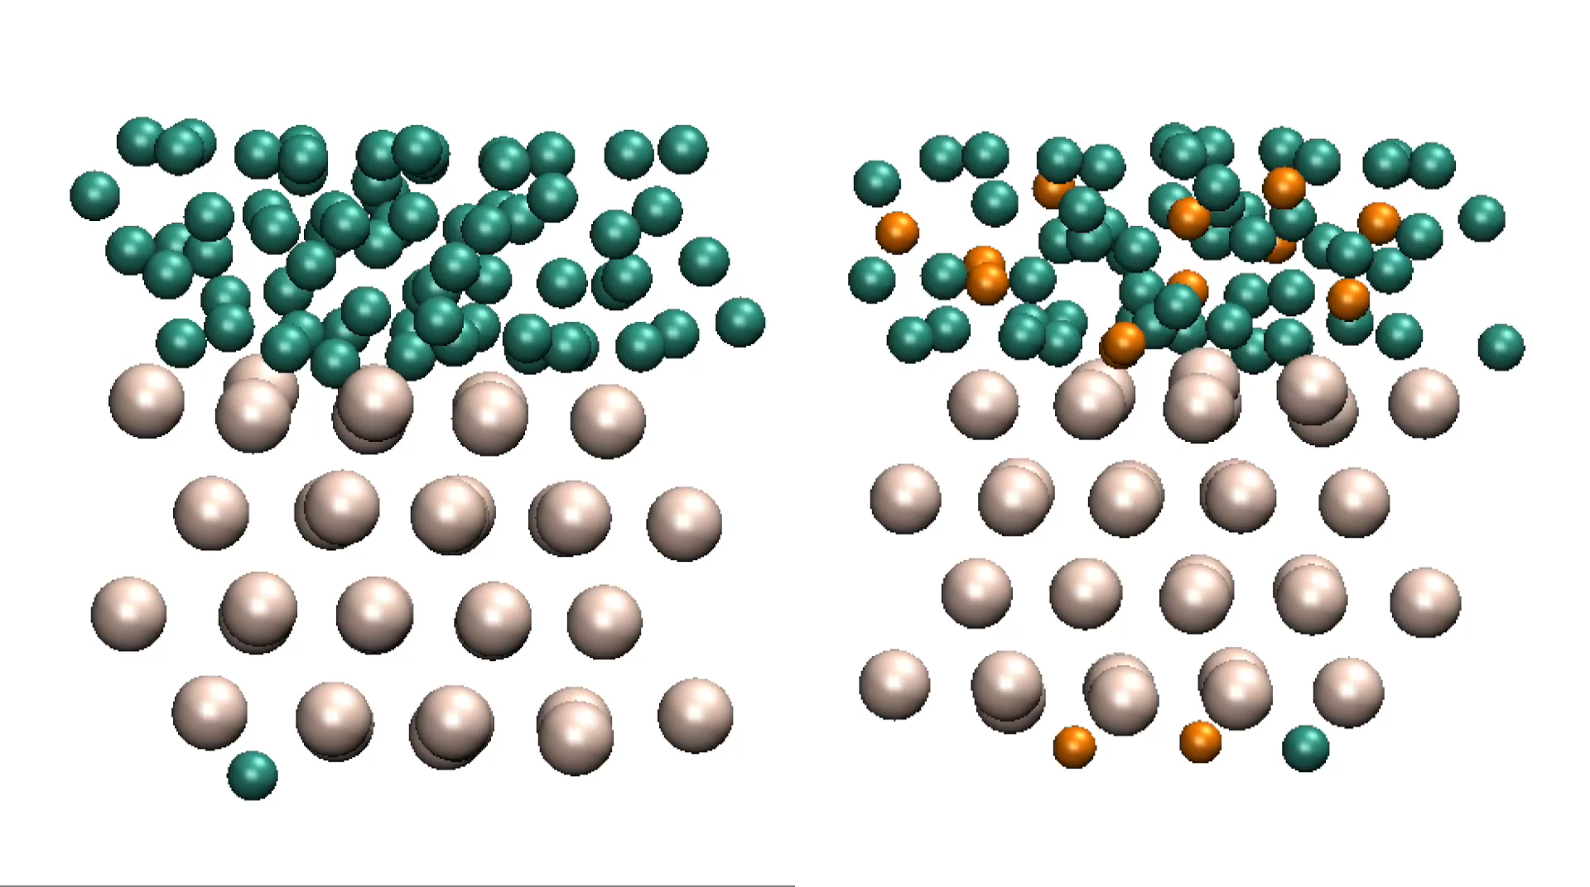
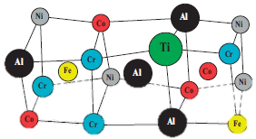
Motivation
Hydrogen diffusion into metals and alloys can cause embrittlement and result in cracking
Nature 602, 437-441 (2022)
Fundamental understanding of hydrogen diffusion is needed
Order of atomic configuration in alloys
Solute concentration of alloys
A₉₉B₁
…
A₅₀B₅₀
Adrián Del-Pozo et al., Current Trends and Future Developments on (Bio-) Membranes, 2020, 139-168
D. Lee, J. J. Vlassak, K. Zhao, ACS Applied Materials & interfaces 8, 10995-11000 (2016)

Slide 3

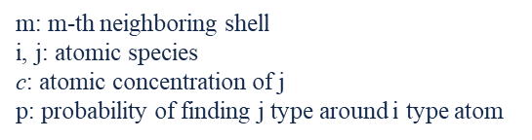
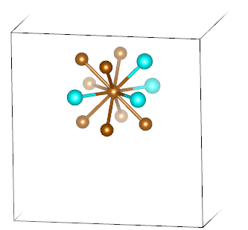
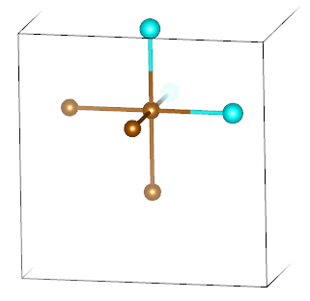
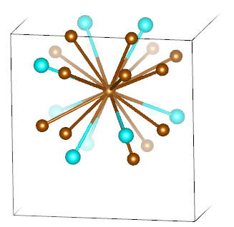
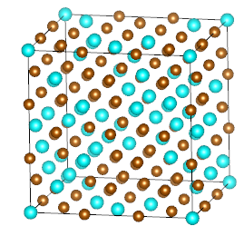
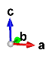
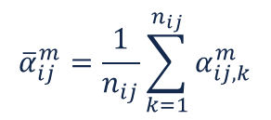
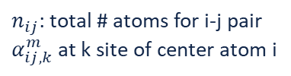
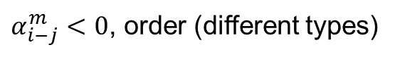
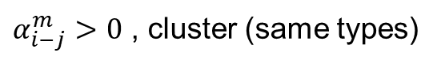
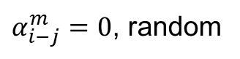
Short-range order
Simple way to characterize short-range order (SRO) of alloys
Warren-Cowley SRO parameter
Consider different nearest neighbor (NN) atoms
Cu
Al
$α_{i−j}^{m}>0$ , cluster (same types)
$α_{i−j}^{m}=0$, random
$α_{i−j}^{m}<0$, order (different types)
1st NN shell
2nd NN shell
3rd NN shell
J. M. Cowley, Physical Review 120, 1648-1657, 1960
N. Norman, B. E. Warren. Journal of Applied Physics 22, 483-486, 2004
Average for overall supercell

Slide 4
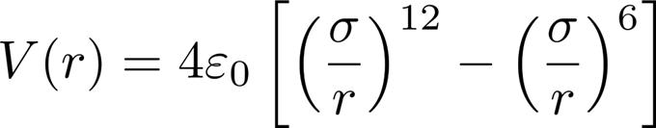
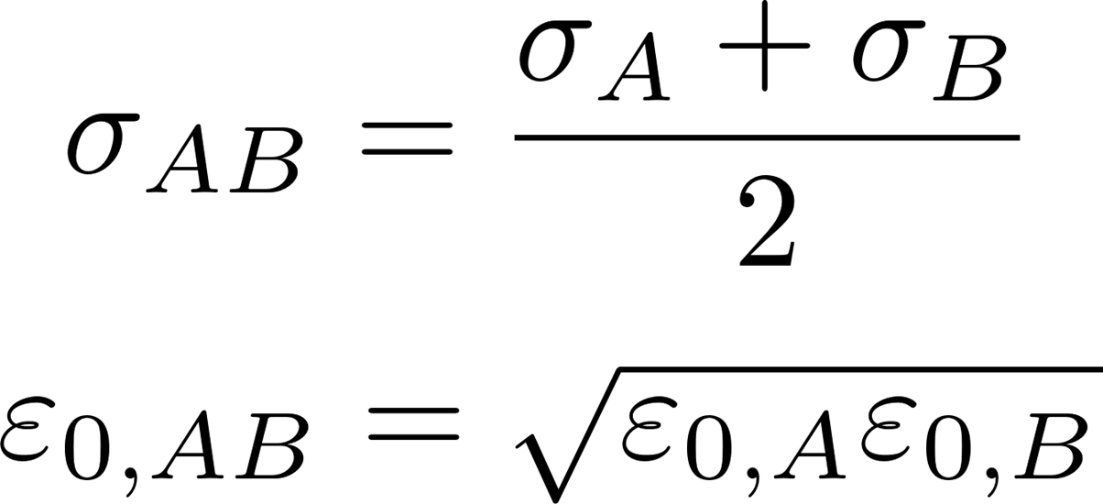
Interatomic potential
Lennard-Jones (LJ) potential
Lorentz-Berthelot combination rule
 | ε₀ [eV] | σ [Å] | A [eV/Å¹²] | B [eV/Å⁶]
Cu | 0.2047 | 2.616 | 21023 | 131.2
Al | 0.1743 | 2.925 | 68384 | 218.3
H | 0.0016 | 2.460 | 309.7 | 1.397
 | In this work | Experiment
Cu | 3.646 Å | 3.61 Å
Al | 4.079 Å | 4.05 Å
Literature data of the LJ potential for the simulation elements**
Benchmark of LJ potential parameters on determination of lattice constants in angstrom (Å) for example metals**
*N. Hu, X. Sun, and A. Hsu, The Journal of chemical physics, 123, 4, 2005.
**W. P. Davey, Physical Review, 25, 6, 753, 1925.

Slide 5
Implementation

Slide 6
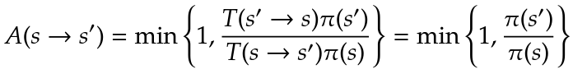
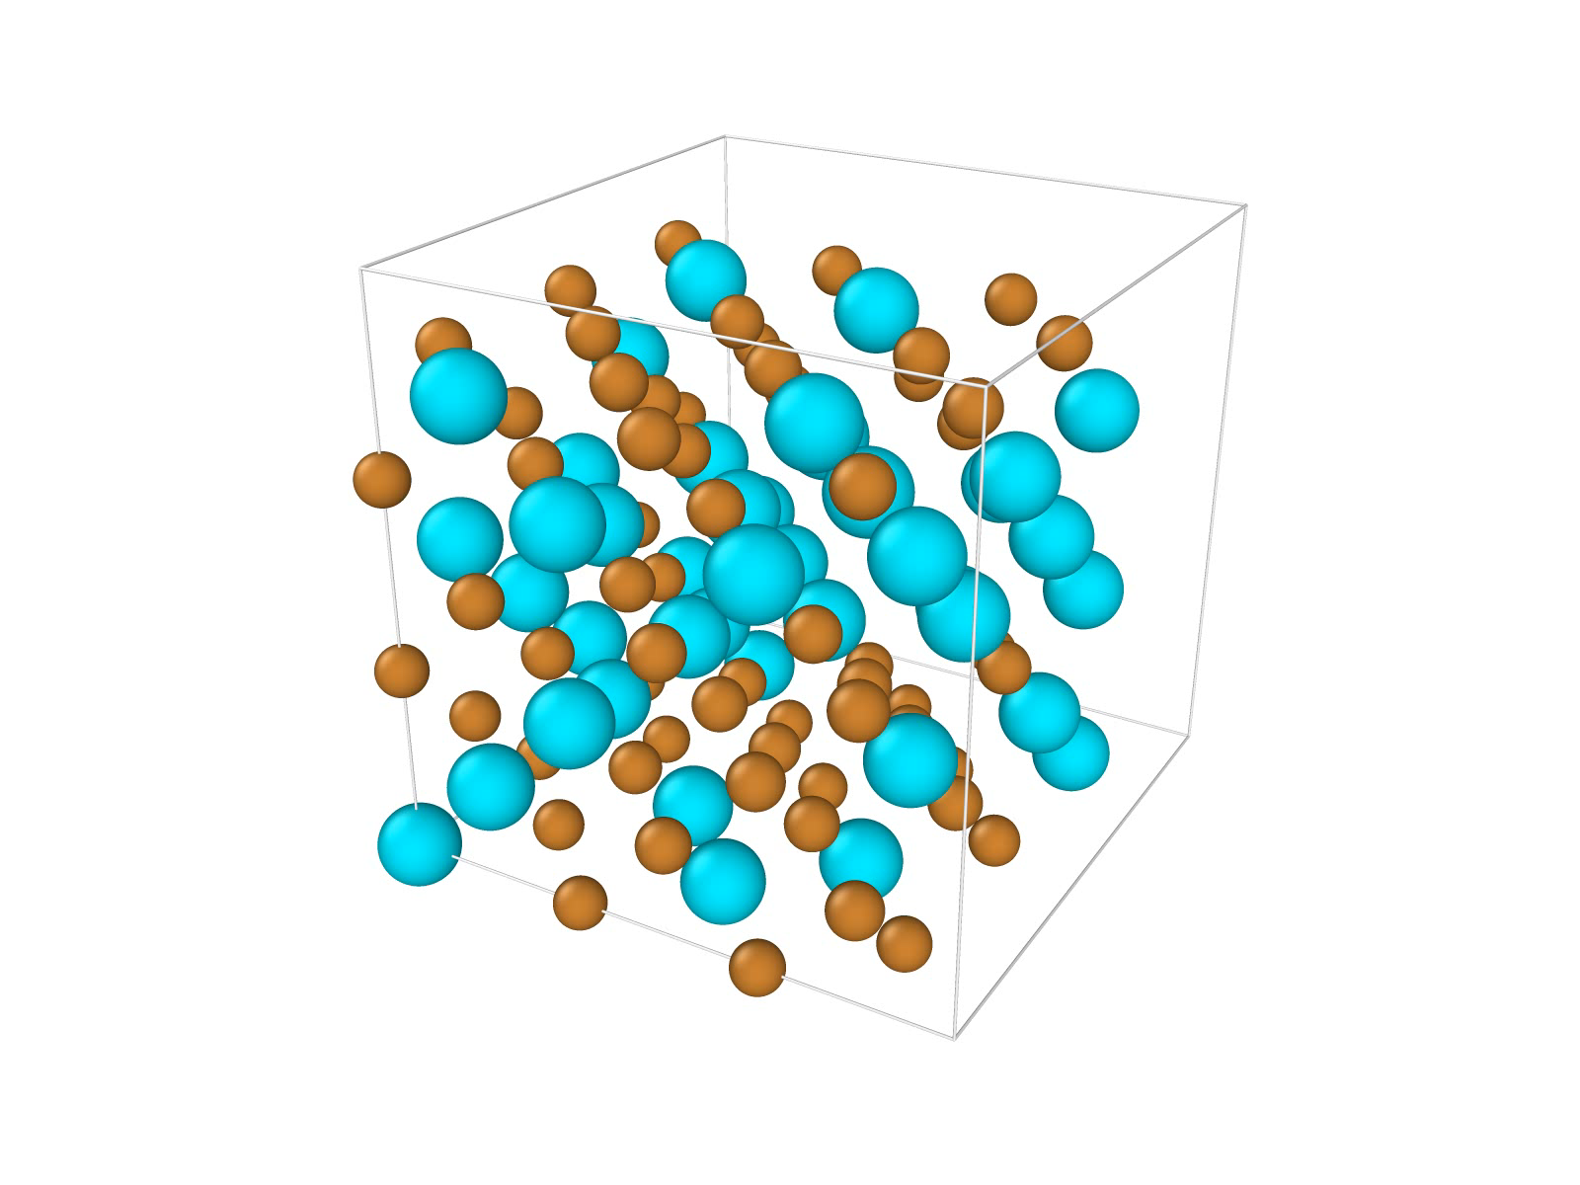
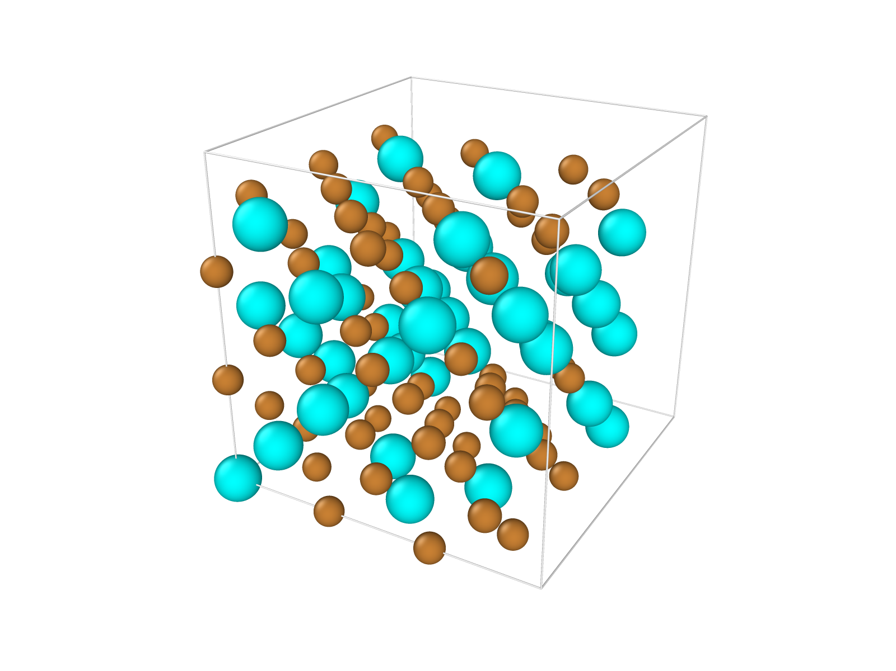
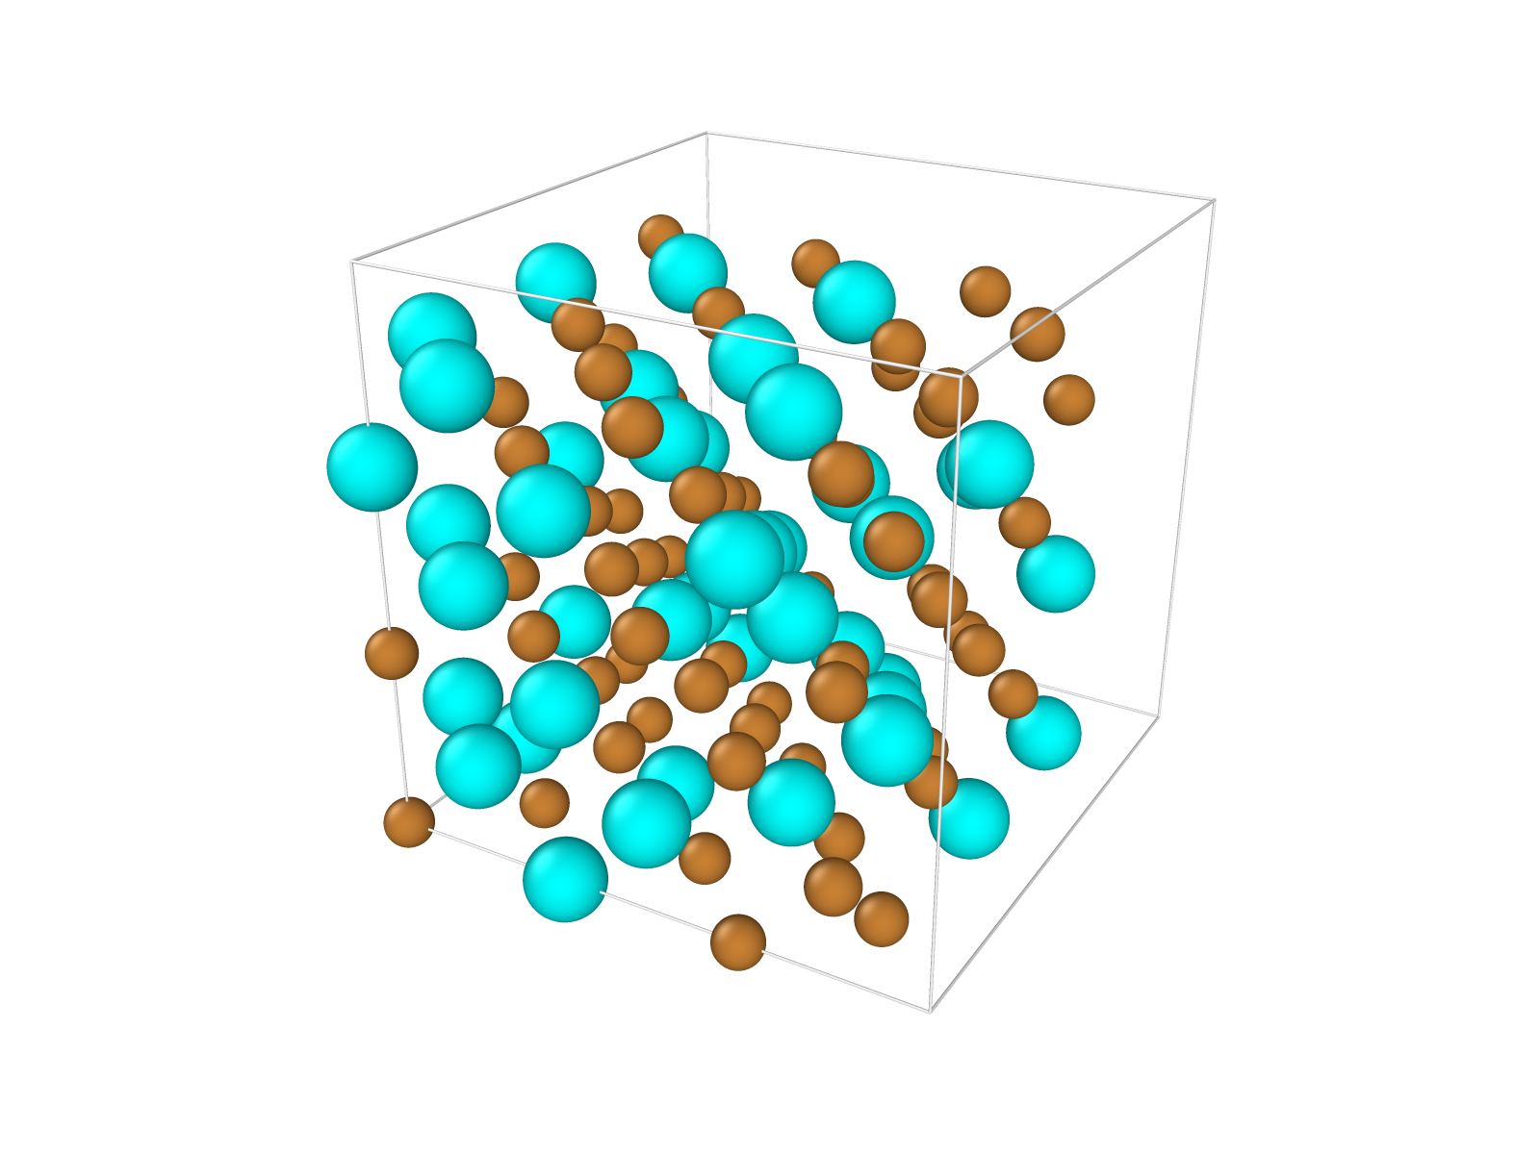
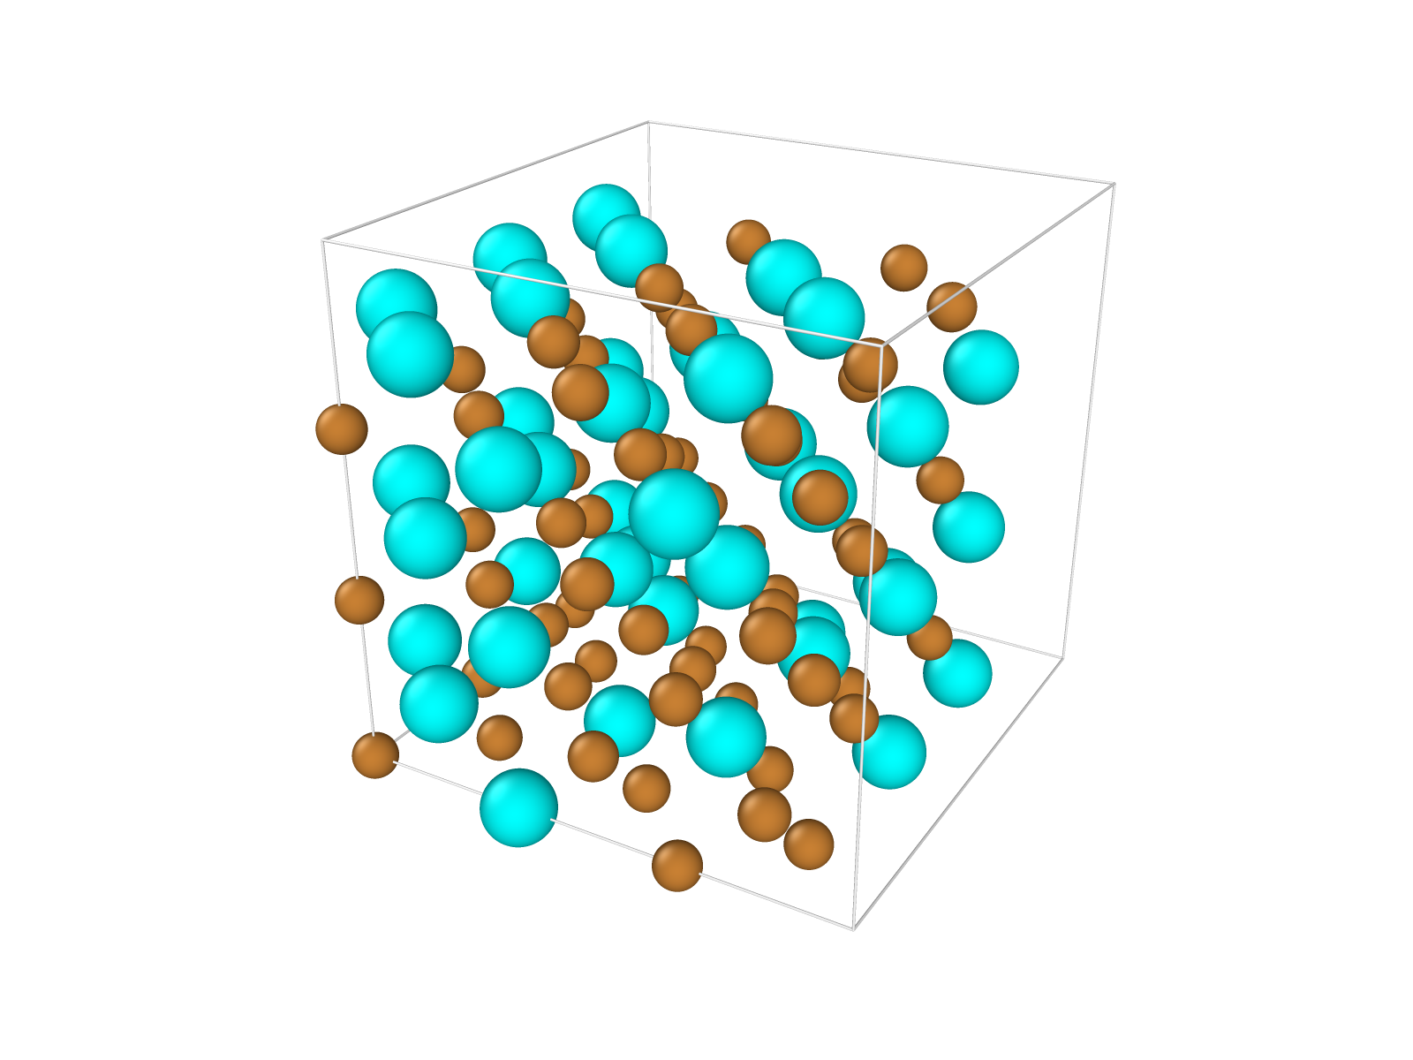
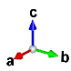
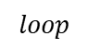
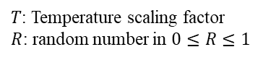
Monte Carlo swapping atomic species
Construction of different SRO configuration of alloys
Initial random configuration
Cu₈₀Al₂₀
Randomly swap between Cu and Al atom
$$loop$$
ex) 1 Cu <-> 1 Al
LJ-based energy calculation
Metropolis criterion
Accept the configuration
Save data
Reject the configuration
Recall the previous one
Random
Intermediate
Final
$T$: Temperature scaling factor
$R$: random number in $0≤R≤1$
Selected 3 configurations

Slide 7
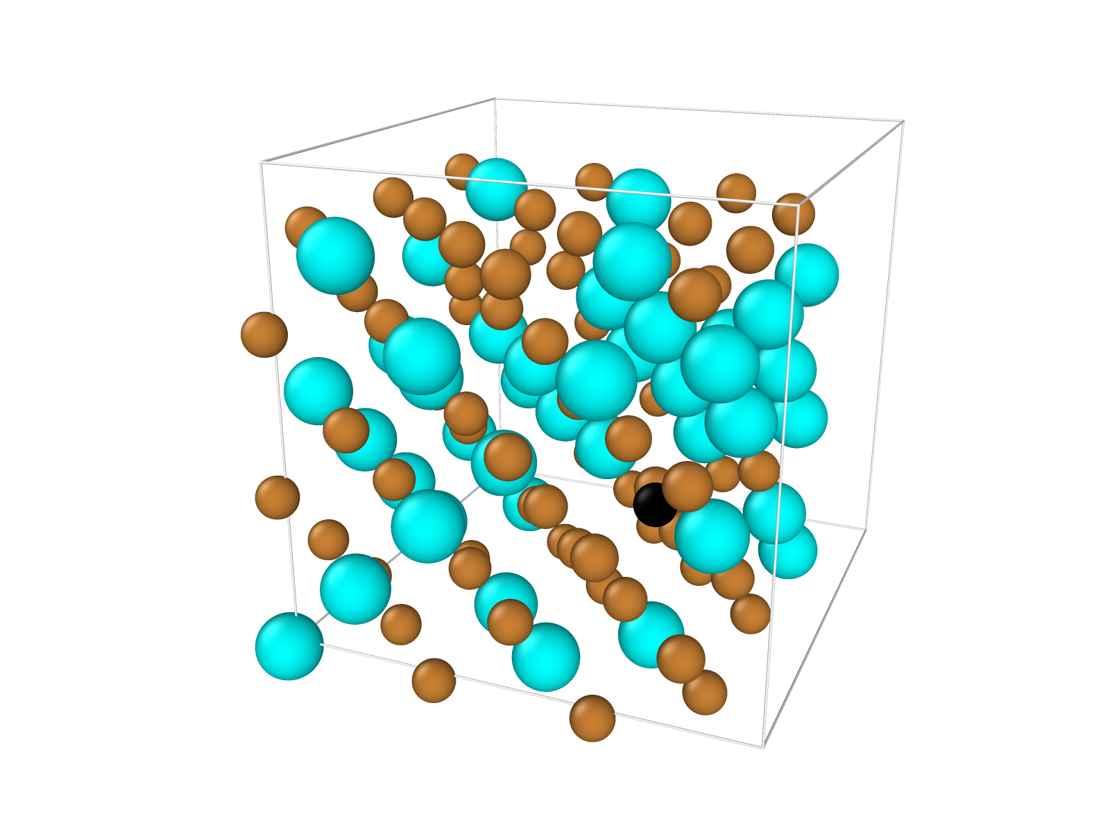
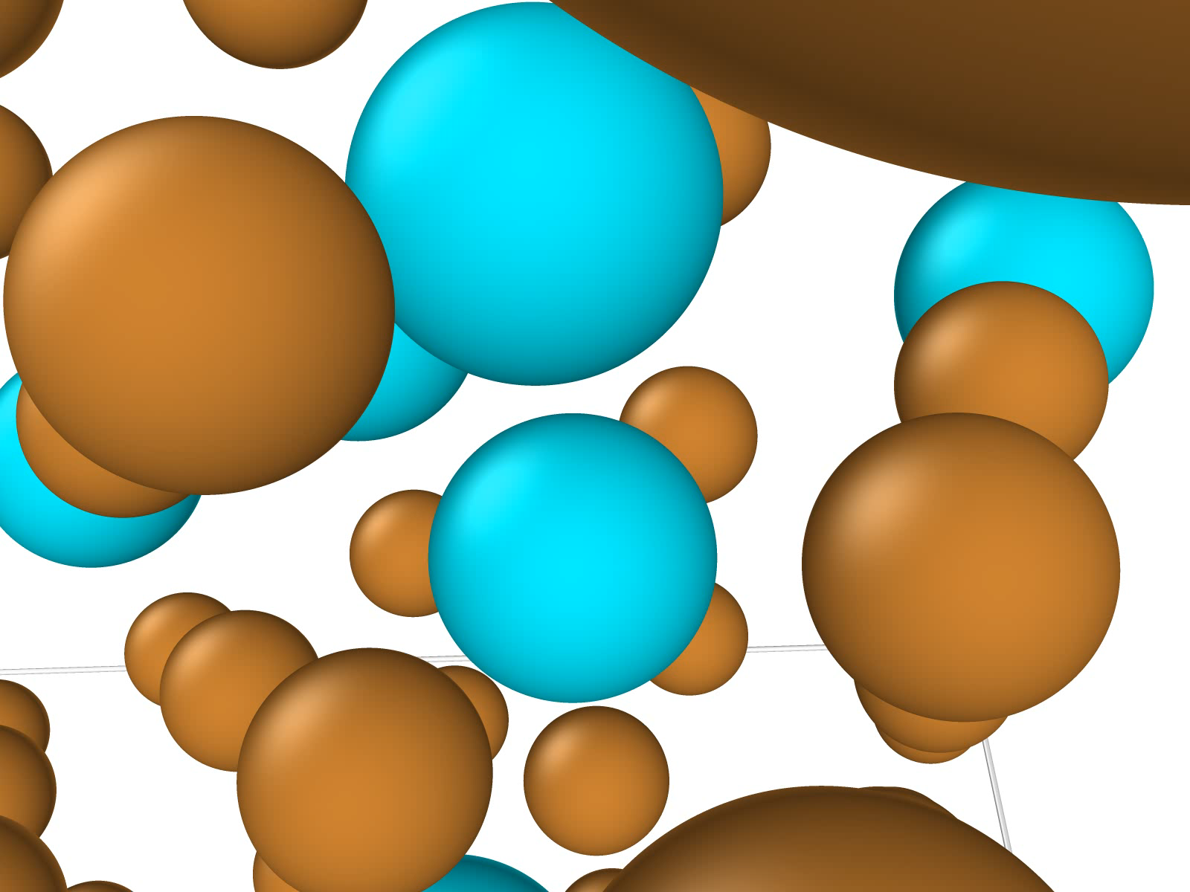
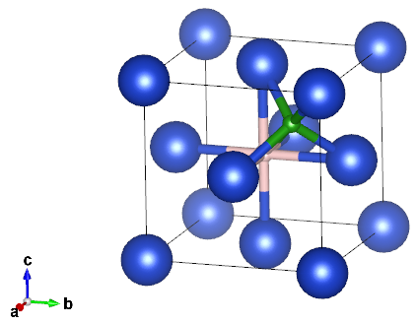
MD Relaxation
LJ-based MD relaxation of FCC structure
We equilibrate the selected atomic structures from the MC swapping without hydrogen
Then add hydrogen to interstitial site and equilibrate again
Cu
Al
H
FCC interstitial sites:
Optimized Lattice Parameters:
Lattice
Octahedral (Octa)
Tetrahedral (Tetra)
 | In this work
Cu₈₀Al₂₀ | 3.764 Å
Cu₆₀Al₄₀ | 3.863 Å

Slide 8
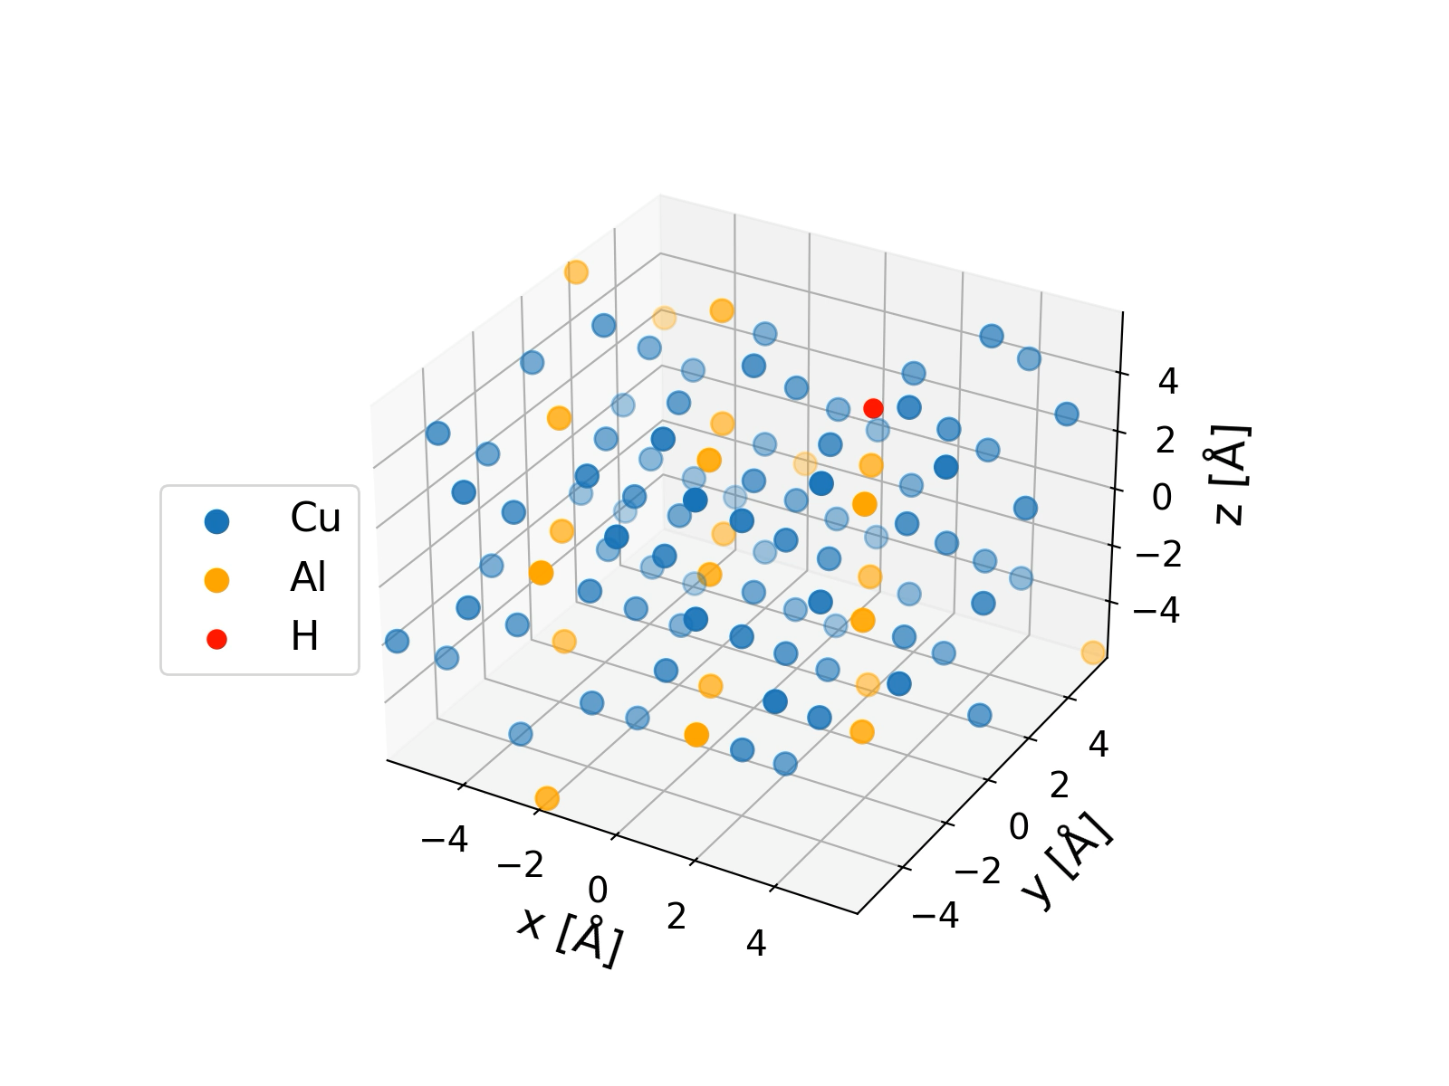
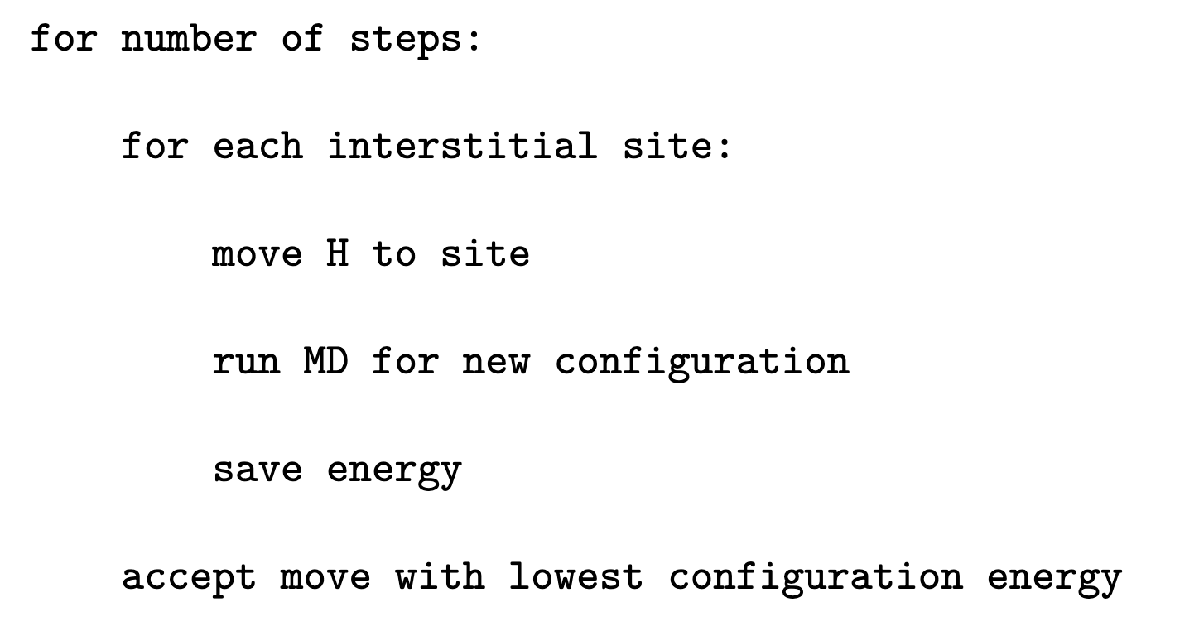
MD Hydrogen Stepping
Initial configuration from MD relaxation

Slide 9
Results

Slide 10
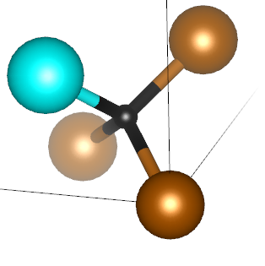
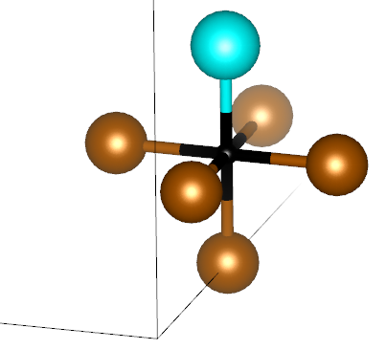
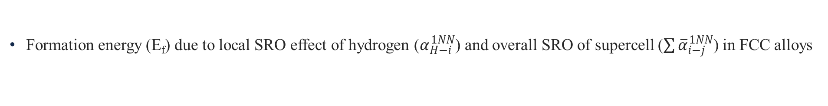
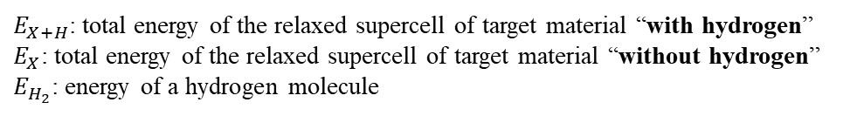
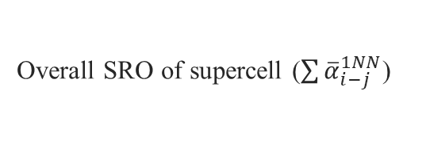
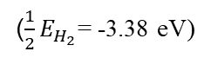
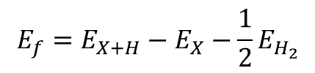
Molecular dynamics simulation
Formation energy (E_{f}) due to local SRO effect of hydrogen ($α_{H−i}^{1NN}$) and overall SRO of supercell ($\sum{{\overline{α}}_{i−j}^{1NN}}$) in FCC alloys
$$E_{f}=E_{X+H}−E_{X}−\frac{1}{2}E_{H_{2}}$$
$E_{X+H}$: total energy of the relaxed supercell of target material “with hydrogen”
$E_{X}$: total energy of the relaxed supercell of target material “without hydrogen”
$E_{H_{2}}$: energy of a hydrogen molecule
($\frac{1}{2}E_{H_{2}}$= -3.38 eV)
Overall SRO of supercell ($\sum{{\overline{α}}_{i−j}^{1NN}}$)
Local SRO of hydrogen
D. You et al., Scripta Materialia 183 (2020) 1–5
X. L. Ren et al., Acta Materialia 180 (2019) 189-198

Slide 11
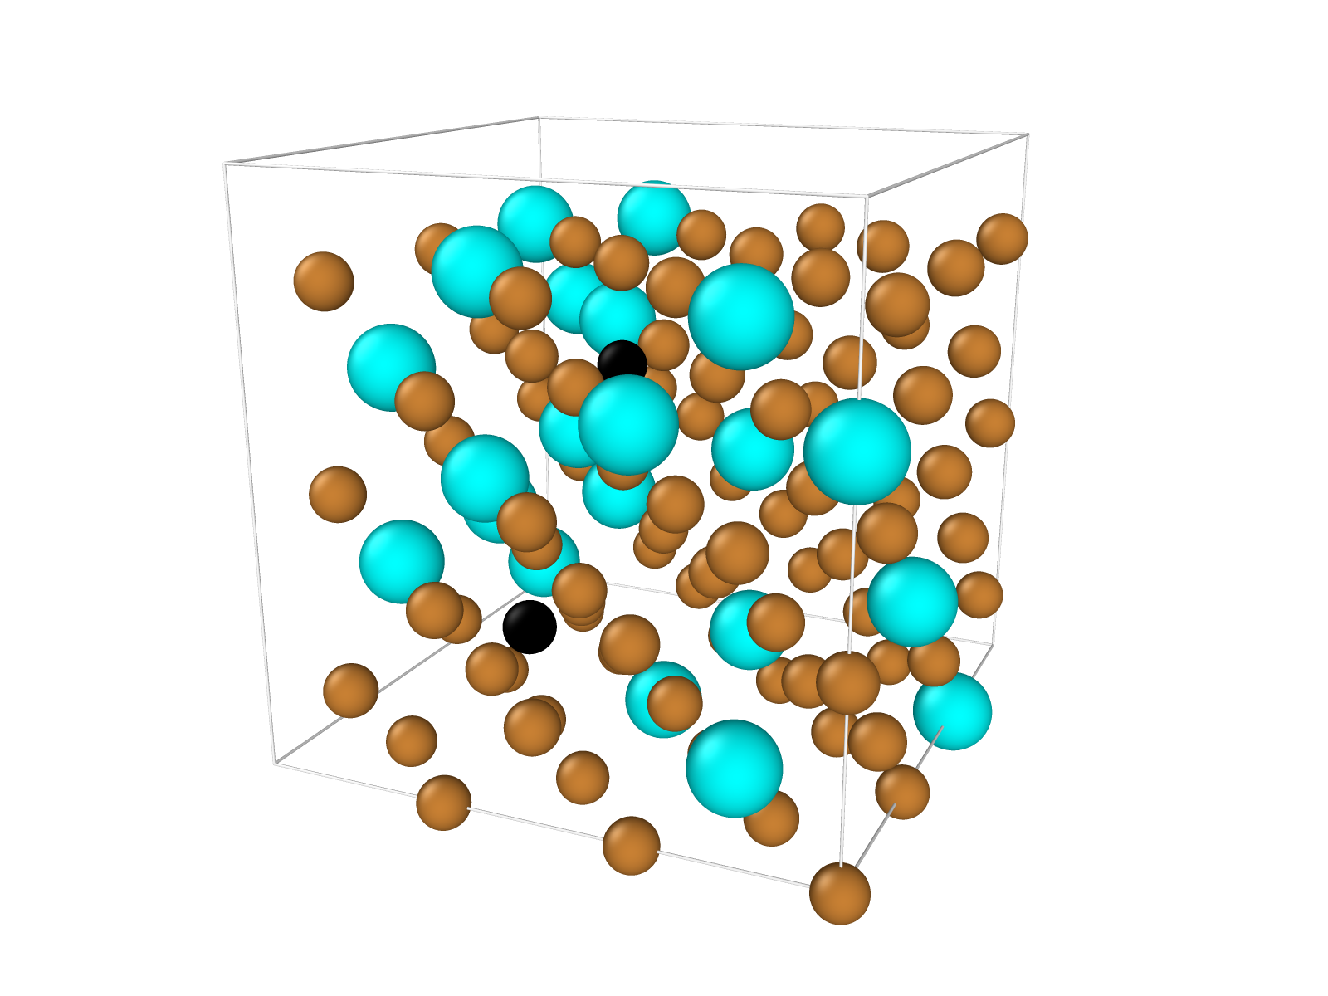
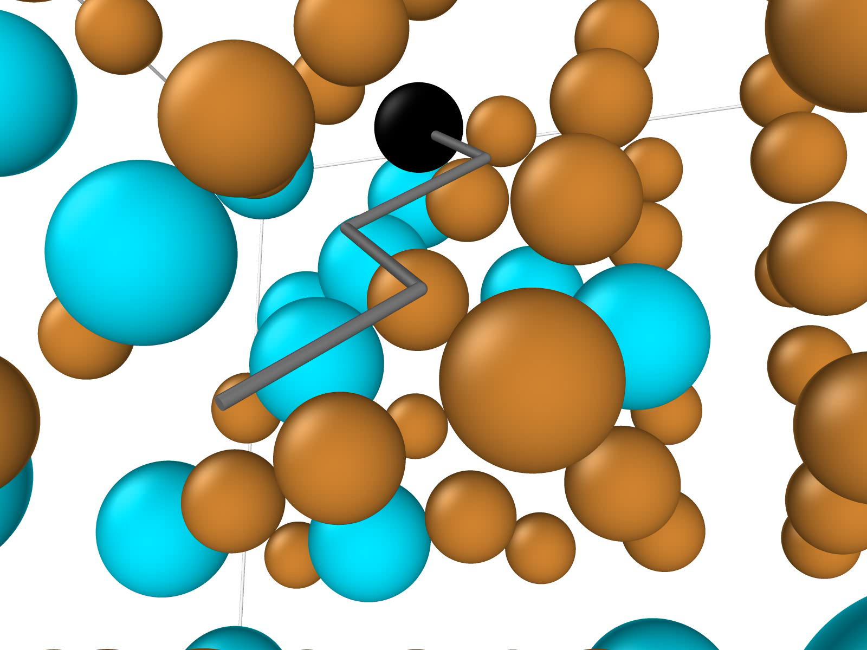
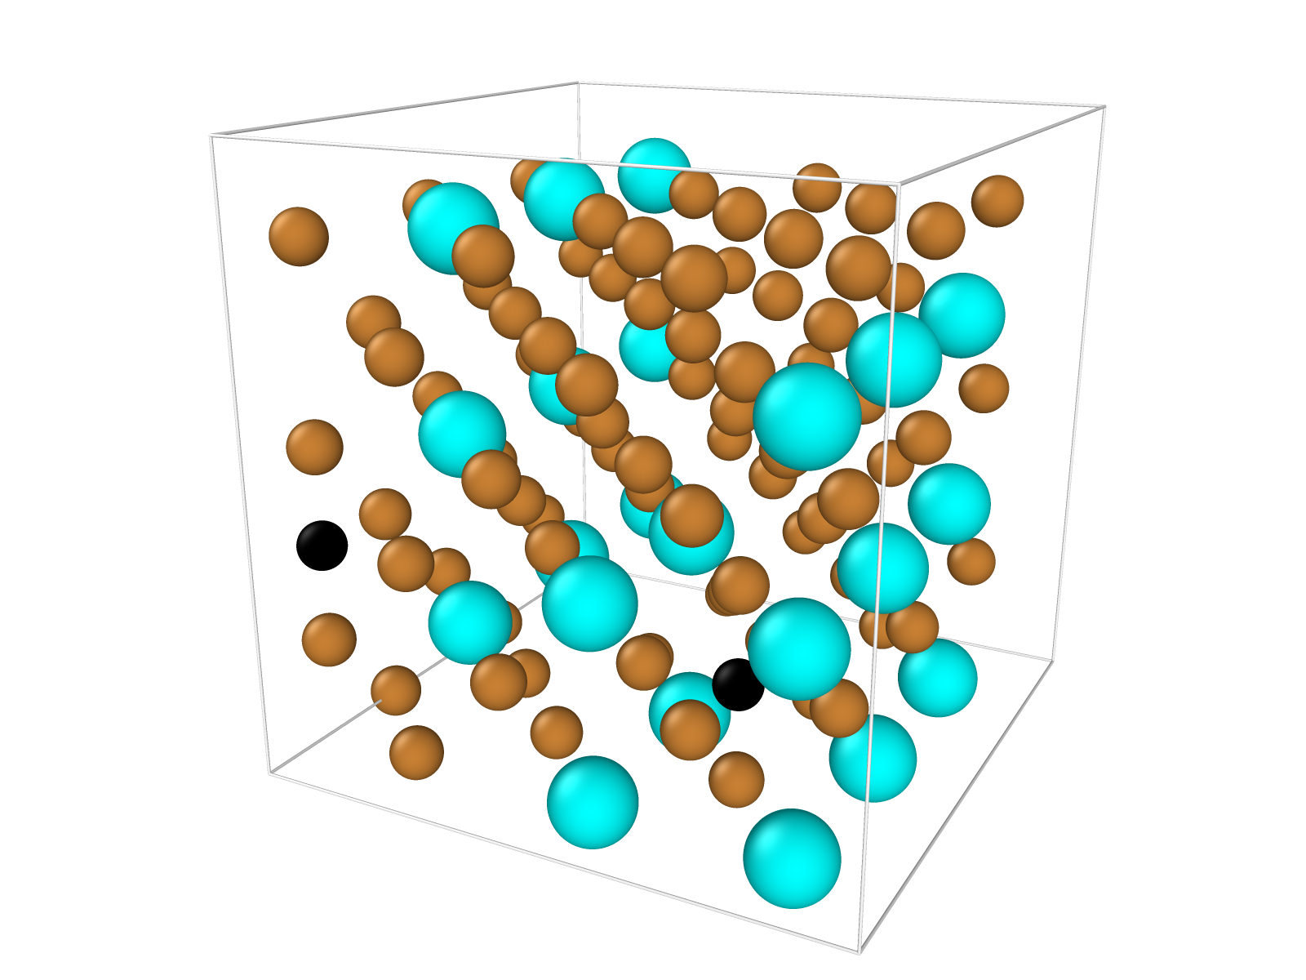
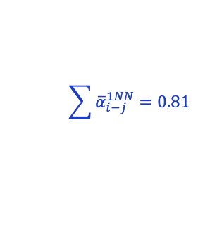
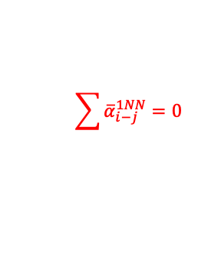
Diffusion of hydrogen
Diffusion pathways are estimated by the formation energy in different interstitial sites
Local SRO of hydrogen is correspondingly recorded
c
a
b
$$\sum{{\overline{α}}_{i−j}^{1NN}}=0$$
Cu
Al
H
$$\sum{{\overline{α}}_{i−j}^{1NN}}=0.81$$

Slide 12
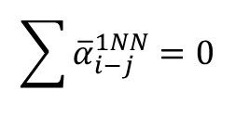
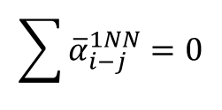
Diffusion of hydrogen
Effect of Al solute concentration and temperature in formation energy upon diffusion
Cu₈₀Al₂₀
No ordering effect
Thermally assisted
$$\sum{{\overline{α}}_{i−j}^{1NN}}=0$$
$$\sum{{\overline{α}}_{i−j}^{1NN}}=0$$

Slide 13
Conclusion and Limitations
Local SRO of hydrogen
MC swapping of atomic species development
Stability of hydrogen interstitial with both local and bulk SRO effect
Estimation of diffusion pathways of hydrogen in FCC metals and alloys
SRO, temperature, and solute concentration effects for hydrogen diffusion
Electron and charge fields of atoms
LJ potential with Lorentz-Berthelot rule
Neglect supercell size effect

Slide 14
Questions?

